Slide 1


P.Ramadoss
Assistant Professor,
Department of Information Technology,
VFSTR (Deemed to be)University,
Guntur, Andhra Pradesh.

Slide 2
Objectives
Identify Regular Expression approach to describing languages
To understand Construct an NFA, DFA from regular expression

Slide 3
Outcomes
Students can able to describe the syntax of programming language constructs.
The student will be able to construct the
equivalent of E-NFA, DFA, & RE.

Slide 4
Finite Automata (FA) & Regular Expressions (Reg Ex)
To show that they are interchangeable, consider the following theorems:
  Theorem 1: For every DFA A there exists a regular expression R such that L(R)=L(A)
  Theorem 2: For every regular expression R there exists an ε -NFA E such that L(E)=L(R)
Kleene Theorem
ε -NFA
NFA
Theorem 2
Reg Ex
DFA
Theorem 1
Notes:
Cpt S 317: Spring 2009
School of EECS, WSU

Slide 5
Kleene’s Theorem
A language is said to be regular if it can be represented by using a Finite Automata or if a Regular Expression can be generated for it. This definition leads us to the general definition that; For every Regular Expression corresponding to the language, a Finite Automata can be generated.

Slide 6

From a Regular Expression to an NFA
Now give an algorithm to construct an NFA
from a regular expression.
The algorithm is syntax-directed in that it uses the syntactic structure of the regular expression to guide the construction process.
Algorithm: (Thompson's construction):
Input: a regular expression R over alphabet ∑.
Output: NFA N accepting L(R).
1- For , construct the NFA

Slide 7

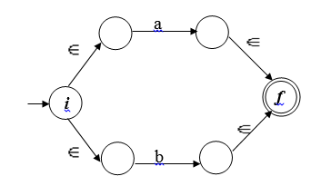
From a Regular Expression to an NFA
2- For a in ∑, construct the NFA
3- For the regular expression a | b construct the
following composite NFA N(a | b).

Slide 8
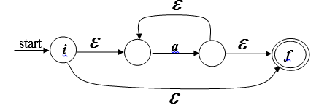
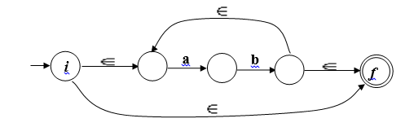
From a Regular Expression to an NFA
4-For the regular expression a* construct the following composite NFA N(a*).
RE = (ab)*

Slide 9
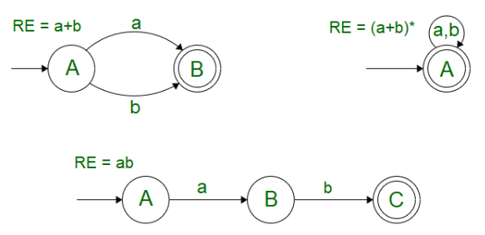
Kleene’s Theorem
For any Regular Expression r that represents Language L(r), there is a Finite Automata that accepts same language.

Slide 10
Kleene’s Theorem-1
Say, and be two regular expressions. Then,
r1+r2 is a regular expression too, whose
corresponding language is L(r1) U L(r2).
2. r1.r2 is a regular expression too, whose
corresponding language is L(r1).L(r2)
3. r1* is a regular expression too, whose
corresponding language is L(r1*)

Slide 11
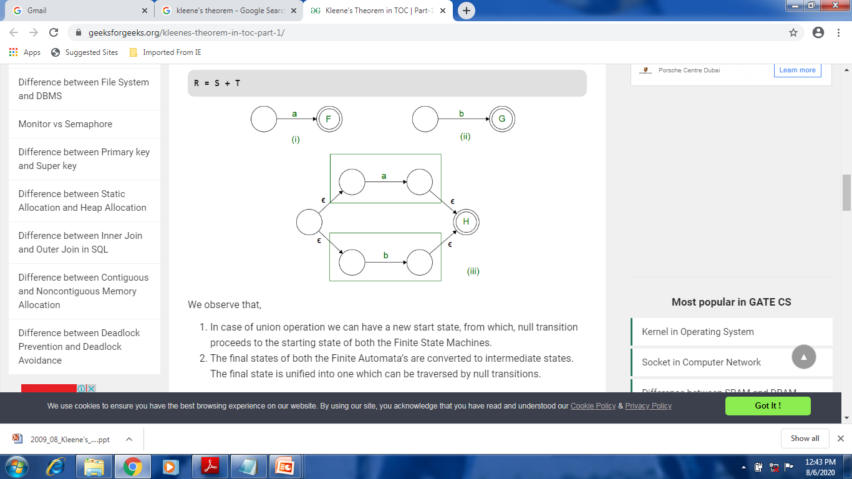
Kleene’s Theorem-1
Let S accept L = {a} and T accept L = {b}, then R can be
represented as a combination of S and T using the provided
operations as:
R = S + T

Slide 12
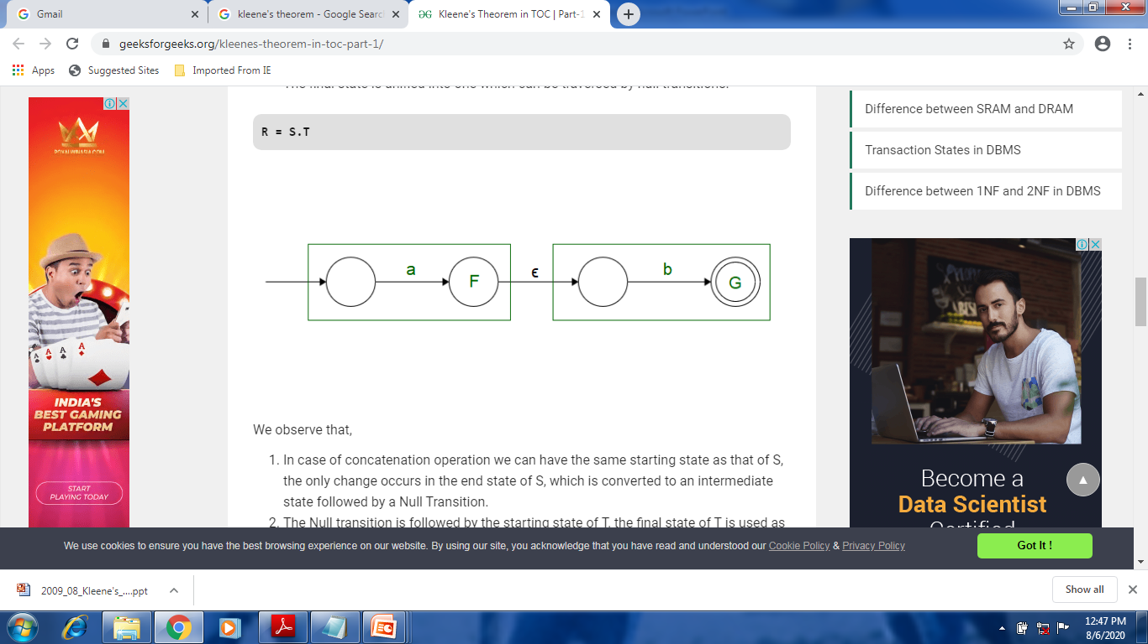
R = S .T

Slide 13
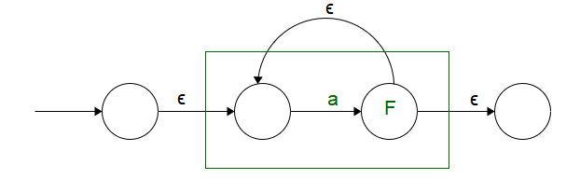
R = S*

Slide 14
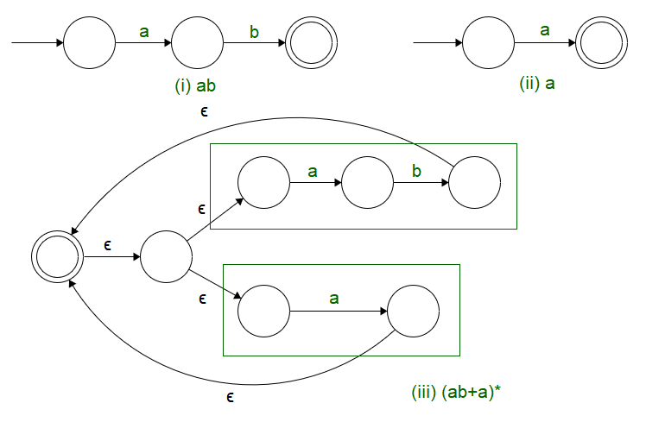
Example: Make a Finite Automata for the expression (ab+a)*

Slide 15
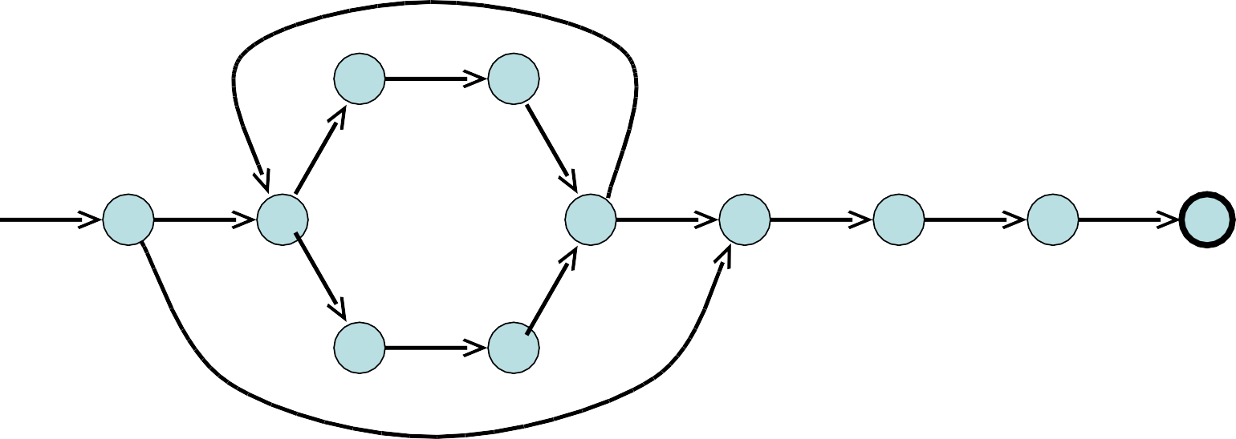
Example: Build a Finite Automata for the expression (a/b)*abb
Subset Construction
ε
a
2 3
ε
ε
ε
4
start
ε
ε
0
1
6
7
a
8
b
9
b
10
b
ε
₅ ε

Slide 16
Subset Construction
40
ε
a
2 3
ε
ε
ε
4
start
ε
ε
0
1
6
7
a
8
b
9
b
10
b
ε
₅ ε
Start state:
ε−Closure (0) = {0, 1, 2, 4, 7 } = A
MoveDFA(A,a) =
ε−Closure (MoveNFA(A,a)) =
ε −Closure ({3,8}) = {1,2,3,4,6,7,8} = B
Dstates
A = {0,1,2,4,7}
B = {1,2,3,4,6,7,8}
C = {1,2,4,5,6,7}
D = {1,2,4,5,6,7,9}
E = {1,2,4,5,6,7,10}

Slide 17
Subset Construction
40
ε
a
2 3
ε
ε
ε
4
start
ε
ε
0
1
6
7
a
8
b
9
b
10
b
ε
₅ ε
Process C = {1,2,4,5,6,7} MoveDFA(C,a) = {1,2,3,4,6,7,8} = B MoveDFA(C,b) = {1,2,4,5,6,7} = C
MoveDFA(A,b) =
ε-Closure (MoveNFA(A,b)) =
ε -Closure ({5}) = {1,2,4,5,6,7} = C
MoveDFA(B,b) =
-Closure (MoveNFA(B,b))
Closure ({5,9}) = {1,2,4,5,6,7,9} = D
Process B = {1,2,3,4,6,7,8}
MoveDFA(B,a) = ε -Closure (MoveNFA(B,a))
ε -Closure ({3,8}) = {1,2,3,4,6,7,8} = B

Slide 18




Subset Construction
40
ε
a
2 3
ε
ε
ε
4
start
ε
ε
0
1
6
7
a
8
b
9
b
10
b
ε
₅ ε
b
Dstates
A = {0,1,2,4,7}
B = {1,2,3,4,6,7,8}
C = {1,2,4,5,6,7}
D = {1,2,4,5,6,7,9}
E = {1,2,4,5,6,7,10}
C
b
a
a
b
start
b
b
A
B
D
E
a
a
a

Slide 19
DFA to RE construction
DFA
Reg Ex
Theorem 1
Informally, trace all distinct paths (traversing cycles only once) from the start state to each of the final states and enumerate all the expressions along the way
1
0
0,1
q₀
0
q₁
1
q₂
Example:
(1*)
0
(0*)
1
(0 + 1)*
1*
00*
1
(0+1)*
Q) What is the language?
1*00*1(0+1)*
Notes:
Cpt S 317: Spring 2009
School of EECS, WSU

Slide 20
RE to ε-NFA construction
Reg Ex
ε -NFA
Theorem 2
Example:
(0+1)*01(0+1)*
(0+1)*
01
(0+1)*
ε
ε
ε
0
ε
ε
0
ε
ε
0
1
ε
1
ε
ε
1
ε
ε
ε
Notes:
Cpt S 317: Spring 2009
School of EECS, WSU

Slide 21
Exercise
Construct a NFA equivalent to the following regular expression (0+1)*
2. Construct a NFA equivalent to the following regular expression ((10)+(0+1)*)01.
Notes:
Cpt S 317: Spring 2009
School of EECS, WSU

Slide 22
THANK YOU
Notes:
Cpt S 317: Spring 2009
School of EECS, WSU

Slide 23
Arden’s Theorem
Let P and Q be two regular expressions over alphabet Σ.
If P does not contain null string, then R = Q + RP has a unique solution that is R = QP*.
Proof:
Put the value of R in the R.H.S.
R = Q + (Q + RP)P = Q + QP + RP2
When we put the value of R again and again we get the following equation
R = Q + QP + QP2 + QP3…..
R = Q(1 + P + P2 + P3 + ….
R = Q(є + P + P2 + P3 + ….
Notes:
Cpt S 317: Spring 2009
School of EECS, WSU

Slide 24
Arden’s Theorem
The second part of the product on the L.H.S can be replaced with the kleen closure. So the equation becomes R = QP*
Arden’s Theorem is popularly used to convert a given DFA to its regular expression.
It states that-
Let P and Q be two regular expressions over ∑.
If P does not contain a null string ∈, then-
R = Q + RP has a unique solution i.e. R = QP*.
Notes:
Cpt S 317: Spring 2009
School of EECS, WSU

Slide 25
Arden’s Theorem
Conditions-
To use Arden’s Theorem, following conditions must be
satisfied-
The transition diagram must not have any ∈ transitions.
There must be only a single initial state.
Notes:
Cpt S 317: Spring 2009
School of EECS, WSU

Slide 26
Arden’s Theorem
Step-01:
Form a equation for each state considering the transitions which comes towards that state.
Add ‘∈’ in the equation of initial state.
Step-02:
Bring final state in the form R = Q + RP to get the required regular expression.
Notes:
Cpt S 317: Spring 2009
School of EECS, WSU

Slide 27
Arden’s Theorem
Arden’s Theorem can be used to find a regular expression for both DFA and NFA.
Note-02:
If there exists multiple final states, then-
Write a regular expression for each final state separately.
Add all the regular expressions to get the final regular expression.
Notes:
Cpt S 317: Spring 2009
School of EECS, WSU

Slide 28
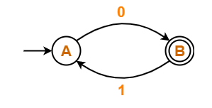
Example :1 Arden’s Theorem
Find regular expression for the following DFA using Arden’s Theorem-
Notes:
Cpt S 317: Spring 2009
School of EECS, WSU

Slide 29
Example :1 Arden’s Theorem
Solution-
Step-01:
Form a equation for each state-
A = ∈ + B.1 ……(1)
B = A.0 ……(2)
Notes:
Cpt S 317: Spring 2009
School of EECS, WSU

Slide 30
Example :1 Arden’s Theorem
Step-02:
Bring final state in the form R = Q + RP.
Using (1) in (2), we get-
B = (∈ + B.1).0
B = ∈.0 + B.1.0
B = 0 + B.(1.0) ……(3)
Using Arden’s Theorem in (3), we get-
B = 0.(1.0)*
Thus, Regular Expression for the given DFA = 0(10)*
Notes:
Cpt S 317: Spring 2009
School of EECS, WSU

Slide 31
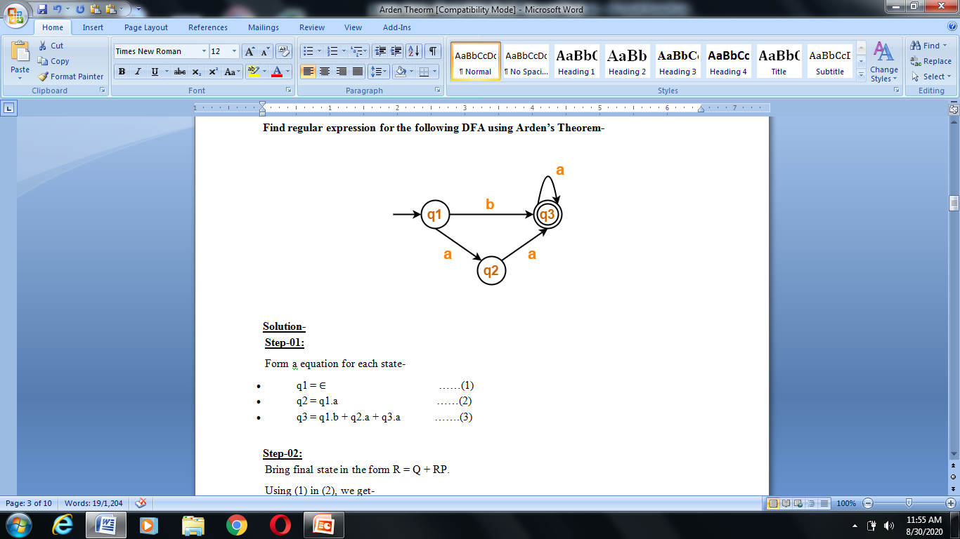
Assignment
Find regular expression for the following DFA using Arden’s Theorem
Notes:
Cpt S 317: Spring 2009
School of EECS, WSU

Slide 32
THANK YOU
Notes:
Cpt S 317: Spring 2009
School of EECS, WSU

